Slide 1
CMO to FMO Migration Application vs Products
Dirk Vermeylen

Slide 2
(Business) Application vs (Technical) Products
(Business) Application
Application Landscape
‘Depends On’ relationship
Candidate for ESL Business Applications
Examples: CADIS, Oracle ERP
(Technical) Product
COTS software
‘Installed On’ relationship
Never a candidate for ESL Business Application, always ESL Solution installed on System
Example: Apache Tomcat 5.5

Slide 3
Business Applications - Instances
Master for Business Applications: Application Portfolio File
Identified by portfolio_id
In CMO / FMO CMDBs: Maintain Business Application Instances
Instance of an Application in an Environment (Production, Development, Staging, Testing, ...)
ESL Solution
Business Application Instance
Technical Product
ESL Instance
Created for Business Application Instance, doesn’t exist in uCMDB, A7, OVSD
Technical Product Installed on System

Slide 4
ESL
Business Product Instances
ESL Solution Category: business application
Technical Products
ESL Solution Categories: collaboration, customer software, database, management tool, os, sap/erp, standard software, webcomponent

Slide 5
OVSD Appl. Instance vs Technical Products
Business Product Instances
Category: BU Managed Application – Custom Application – R+D Application
Link to Application Portfolio file via portfolio_id
Technical Products
Category: Standard Application
Extracted from the Application Relation and DB Relation File
but only use Database Products linked from Database Instances
Technical Product Instances
Category: Database

Slide 6
Assetcenter
Business Application Instances
CI Class: SOL_A&S, SOL_BU, SOL_CUS
Technical Products
for CI Class: SOL_INSTANCE, SOL_SOLUTION
select DISTINCT (‘Oper System’, ‘Operating System Version’)
Technical Product Instances
CI Class: SOL_INSTANCE, SOL_SOLUTION

Slide 7
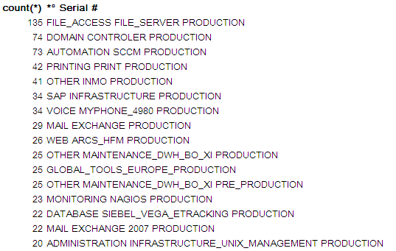
Assetcenter – Technical Product Instances
No issue for CIs linked to 1 system
Application Group for File_Access, Printing, ... ?
Application for Some?
Links to Virtual AND Physical Servers?
How to automate the difference?
For now: handle each CI relation to Server as Installed Technical Product.

Slide 8
Applications – The Numbers
 |  | A7 | OVSD | ESL
 |  |  |  | Total | from A7 | from OVSD | new in ESL
In Portfolio File |  | 231 | 289 | 369 | 98 | 278 | 0
Not in Portfolio File | with PF ID | 30 | 16 | 37 | 23 | 14 | 0
 | no PF ID | 52 | 287 | 306 | 6 | 157 | 143
Total |  | 313 | 592 | 712
In ESL, from A7 / OVSD
Transfer master of CI to uCMDB
new in ESL
Review Category – should not have been business category

Slide 9
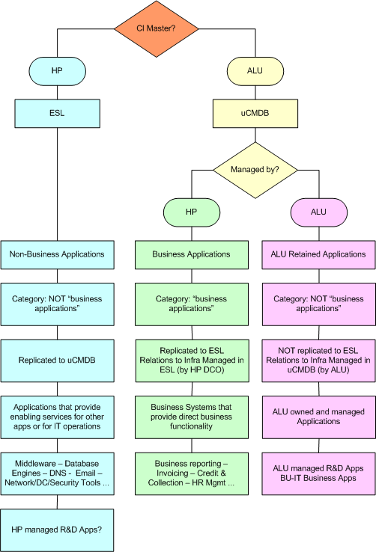
Where to master Business Applications

Slide 10
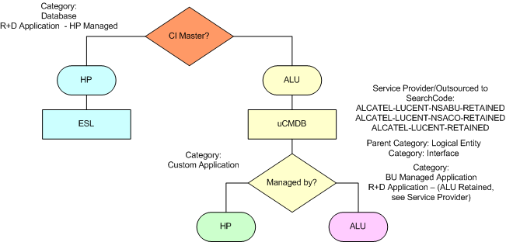
Where to master Bus. Apps - OVSD
to be removed from ESL!

Slide 11
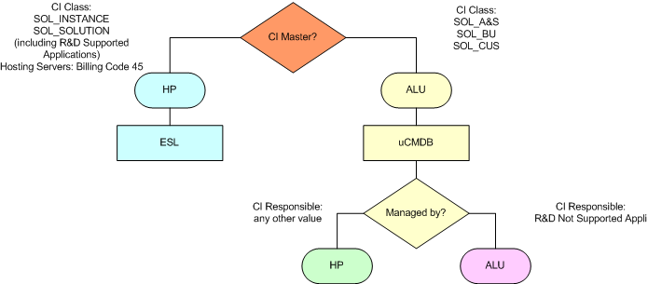
Where to master Bus. Apps – A7

Slide 12
Application Renaming
HP format: name:class:alu
Class will be “app”
Name will be Portfolio Acronym-Instance (e.g., production, development)
Spaces will be replaced with dashes
Name to contain only: lowercase 0..9 - _
Special Characters will be replaced
Name (incl. instance) is limited to 35 characters
Environment (instance) is required, since some solutions have different environments of an application on same server -> distinguish between instances and same naming convention for all.

Slide 13
Application Renaming
appl_name_acronym | appl_name_long | portfolio_id | a7 (*° Serial) | ovsd (searchcode) | Appl. Renaming
CDMS | Livelink CDMS | 70312 | OTHER CDMS PRODUCTION | sw-cus-livelink-cdms-prd | cdms_prd
IAM-Directory | IAM-Directory | 80231 | OTHER IAM-DIRECTORY PRODUCTION | sw-cus-b2a-prd | iam_directory_prd
Livelink wCDMA | Livelink wCDMA | 70692 | OTHER LIVELINK_WCDMA PRODUCTION | sw-cus-livelink-wcdma-prd | livelink_wcdma_prd
LUCIE | LUCIE | 70508 | OTHER LUCIE PRODUCTION | sw-cus-lucie-prd | lucie_prd
OGCAT | OGCAT | 70009 | OTHER OGCAT PRODUCTION | sw-cus-ogcat-prd | ogcat_prd
ORION | ORION | 70049 | OTHER ORION PRODUCTION | sw-cus-orion-sales-prd | orion_prd
PfeBOM | PfeBOM | 70691 | CUS PFEBOM PRODUCTION | sw-cus-pfebom-prd | pfebom_prd
Environment is available for Bus. Apps Instances in A7 and OVSD
what about Database Instance renaming?

Slide 14
Application Renaming Approach
List of Business Applications is available, but requires review for missing Portfolio Applications (see Applications – The Numbers)
New application names to be provided / agreed upon by all interested parties
Input for Data Migration Project
Available for all interested parties
Issues:
Long acronym names
non-ascii characters
Duplicate acronym names
Missing Portfolio Application

